Slide 1
Quality Models

Slide 2
Modeling technique or formalism
Quality Model- A model with the objective to describe, assess and/or predict quality
Quality Meta-Model- A model of the constructs and rules needed to build speciﬁc quality models.
Quality Modeling Framework-A framework to deﬁne, evaluate and improve quality.

Slide 3
Quality Models
McCall’s Quality Model (1977)
Boehm’s Quality Model (1978)
FURPS/FURPS+
Dromey's Quality Model
ISO- ISO 9000 , ISO 9126
Capability Maturity Model(s)
SQALE- Software Quality Assessment based on Lifecycle Expectations

Slide 4
McCall's software quality
factors model
Software quality factors
Product operation factors
Product revision factors
Product transition factors

Slide 5
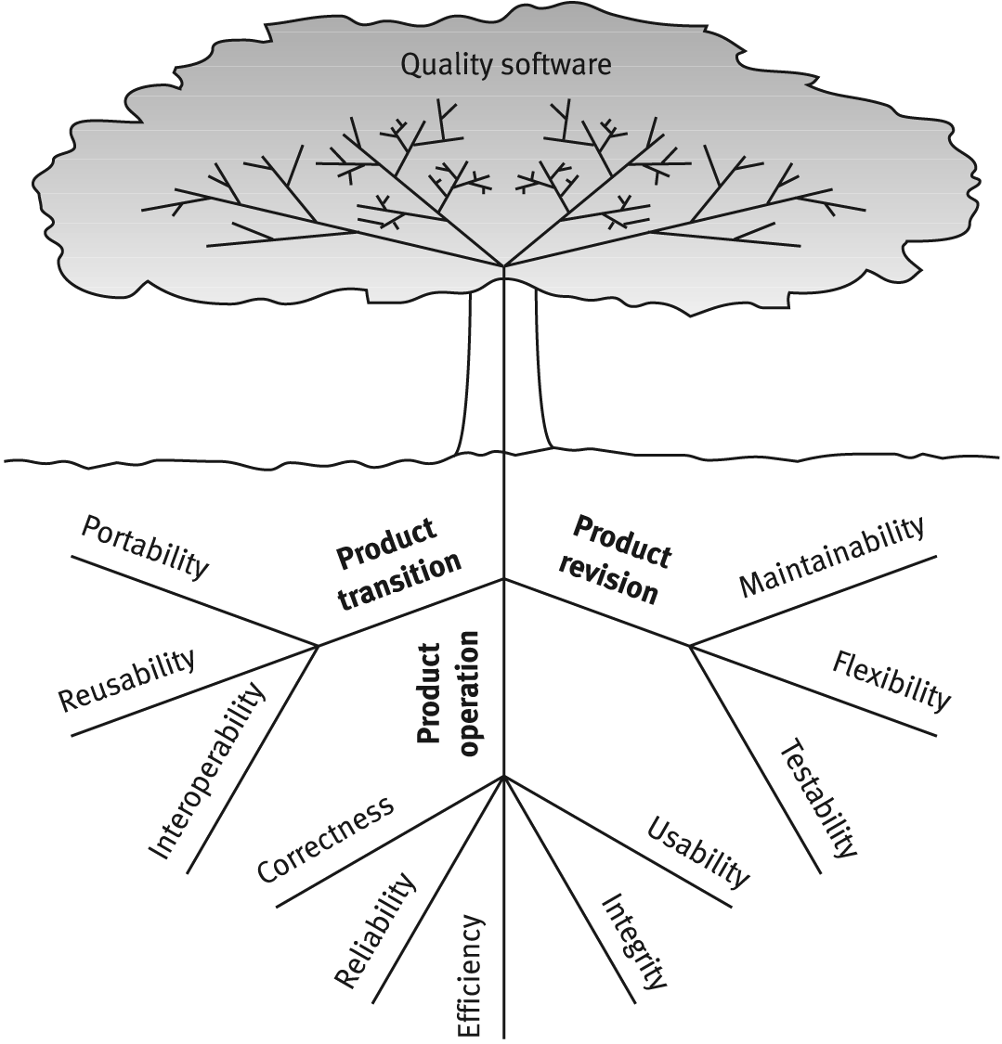
McCalls factor model tree

Slide 6
Boehm’s Quality Model (1978)
His models attempts to qualitatively define software quality by a given set of attributes and metrics.
Boehm's model is similar to the McCall Quality Model in that it also presents a hierarchical quality model structured around high-level characteristics, intermediate level characteristics, primitive characteristics - each of which contributes to the overall quality level.

Slide 7
The high-level characteristics address three main questions :
• As-is utility: How well (easily, reliably, efficiently) can I use it as-is?
• Maintainability: How easy is it to understand, modify and retest?
• Portability: Can I still use it if I change my environment?
The intermediate level characteristic represents Boehm’s 7 quality factors
Portability
Reliability
Efficiency
Usability
Testability
Understandability
Flexibility
The lowest level structure of the characteristics hierarchy in Boehm’s model is the primitive characteristics metrics hierarchy.

Slide 8
FURPS/FURPS+-the FURPS model originally presented by Robert Grady. Stands for Functionality, Usability , Reliability, Performance, Supportability
Dromey's Quality Model - Dromey's proposes a product based quality model that recognizes that quality evaluation differs for each product and that a more dynamic idea for modeling the process is needed to be wide enough to apply for different systems. Attempting to connect software product properties with software quality attributes.

Slide 9
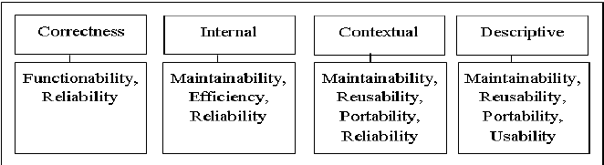

Slide 10
SQALE - Quality Framework or Model
Principles
Quality of the source code is a non-functional requirement
Formalizing requirements in relation to the quality of the source code
Assessing the quality of a source code
Cost remediation to meet the Quality
assesses the importance of a non-conformity quality
SQALE Methods Quality Model is orthogonal
SQALE Method uses addition for aggregating the remediation costs, the non-remediation costs and for calculating its indicators

Slide 11
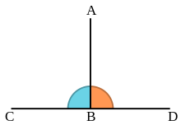

Slide 12
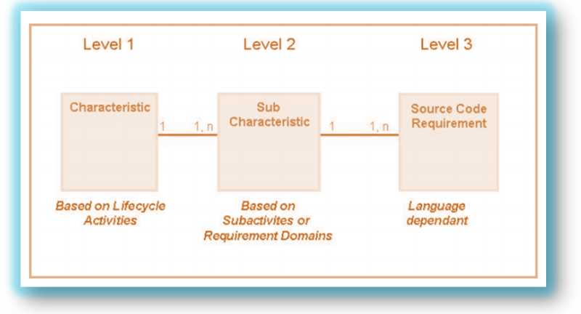

Slide 13
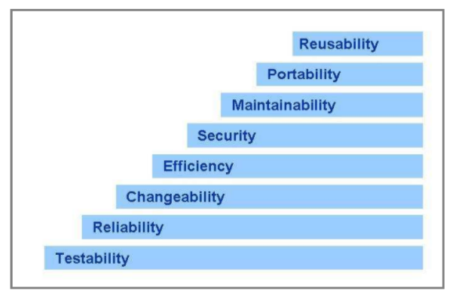

Slide 14
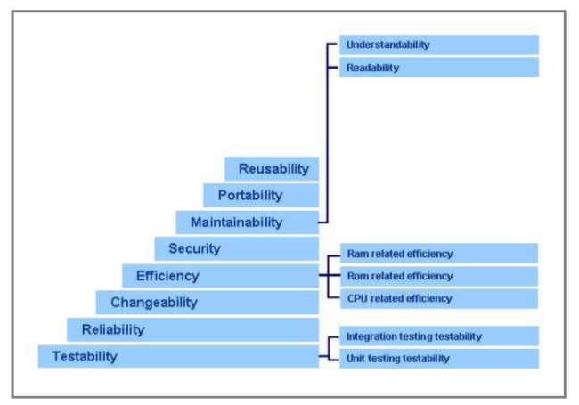

Slide 15
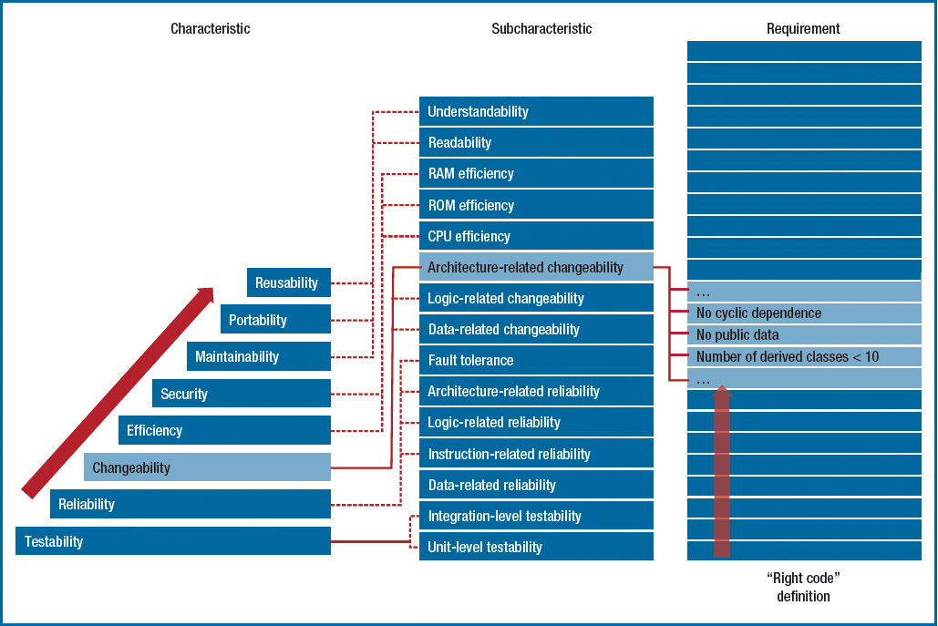

Slide 16
THANKU

